Slide 1
CBR Strategies in
Rural areas
Dr. Doss Prakash
Dept. of community physiotherapy
MGM Institute of Physiotherapy
Chh. SAMBHAJINAGAR

Slide 2
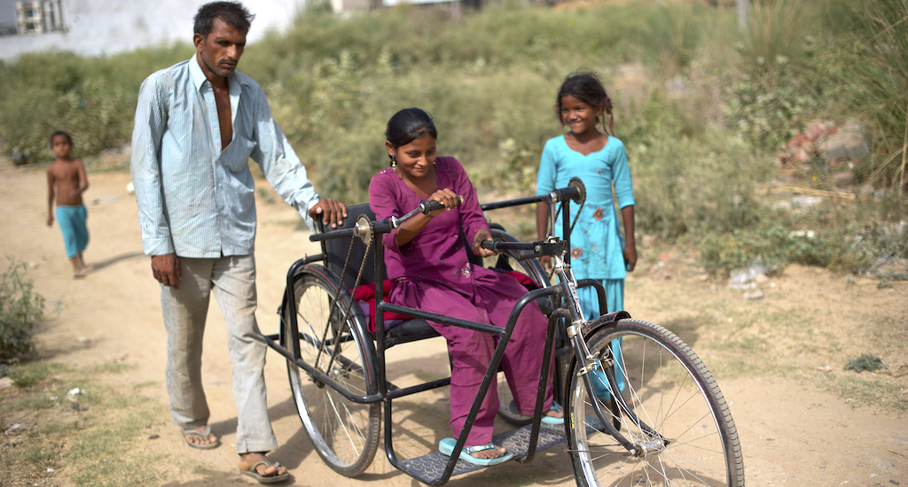

Slide 3
Rural disadvantage extends beyond economic, social and general health indicators to injury and disability.
People with disabilities in rural areas experience significantly more social problems than their urban counterparts, and have access to fewer resources.

Slide 4
Participatory Rural Appraisal
(PRA)

Slide 5
Participatory Rural Appraisal may be seen as a research and development ‘style’ (i.e. a learning outsider working with a community to enable them to explore issues at a local level) rather than a formal method in which an expert employs certain development techniques.

Slide 6
CHARACTERS OF PRA
The use of group processes and community-level interactions (rather than individual interpretation) to share information, collect data, promote analysis of the information and encourage community action.
A long-term ‘time-extensive’ rather than ‘time-intensive’ approach.
Recognition that community-based action is a multitiered process involving: (i) awareness-raising; (ii) building trust; (iii) community-organising; (iv) designing local plans; and (v) effecting change.
The use of visual representations of concepts at local community meetings (‘maps’ and graphic representations of social and other phenomena). These visual tools, when developed by community members and used appropriately, legitimise local knowledge, promote empowerment and enable creative strategies to be developed by participants.

Slide 7
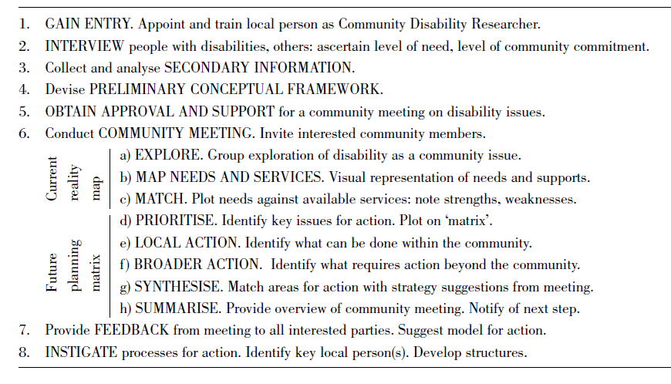
Eight-phase PRA framework utilized for implementing CBR in rural areas

Slide 8
uses
A sustainable service model to respond the needs of people with disabilities.
Greater community awareness of disability issues.
More community support for people with disabilities and their careers.
More effective networking and coordination between community members.
Greater informal and community supports for people wit disabilities.

